Slide 1


EDMS Document Relocation Activity
March 2013

Slide 2
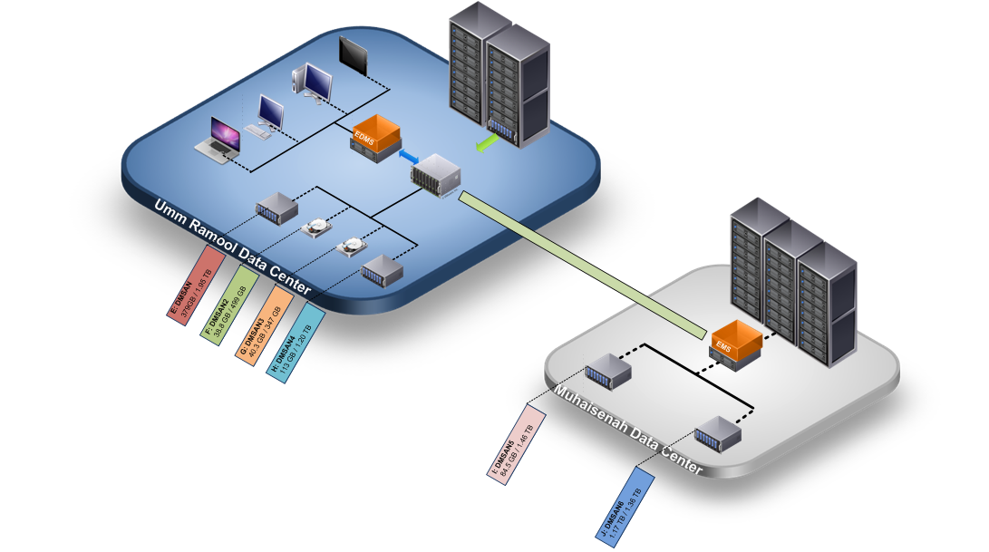
The Big Picture : EDMS Storage Infrastructure.

Slide 3
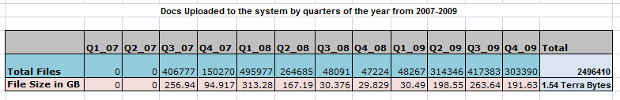

Capacity Planning
April 2010
Estimates: April 2010
Average: 5 GB per day (4 GB – 7 GB per day)
March / April 2013

Slide 4
Value Proposition
1. EDMS & EMS Performance
2. Document Creation Date, Access History
3. Nature of Document
a. EMS_EDMS_ACC
b. EDMS User
c. Backlog Uploader
i. AutoUploader
ii. MGANGULY
iii. ITQAN
4. Other Considerations
a. Document Size
b. Document Type

Slide 5
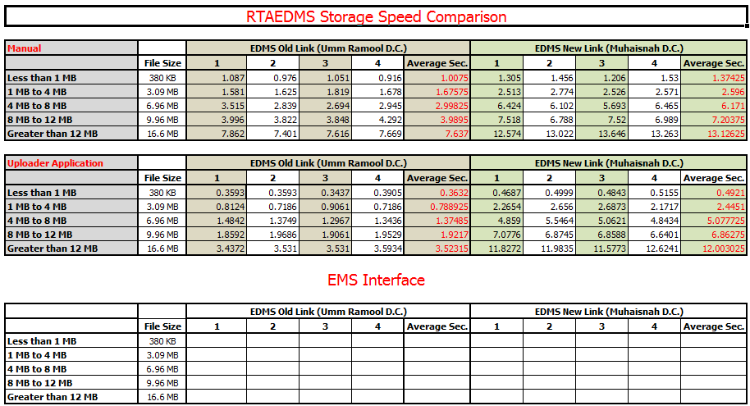
Performance Testing

Slide 6
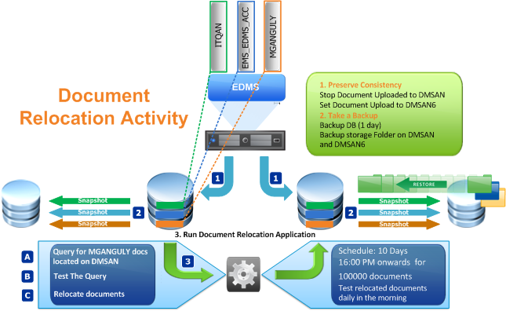
Document Relocation Activity

Slide 7

Facts and Figures
RTA average monthly upload: 50 GB
Space needed on DMSAN: 500 GB (10 months * 50)
Available space on DMSAN6: 1.17 TB
Moving documents uploaded during 2007-2011 from DMSAN TO DMSAN6 will give extra space enough for more than 1 year approx.
Moving MGANGULY documents and documents uploaded till 2010 will give space enough for 8 months approx.
Moving 1,000,000 Documents moved frees space = 500 GB approx.
Assumption: Average Document Size: 500kb approx.
Storage Threshold: 80% of Capacity.

Slide 8


Application Logic:
Create a Search Query
Test query result to estimate size of documents to be moved

Slide 9




Application Logic: Loop over the search result
  Move the document Content from the source document server to the target document server.
  Update the profile table Column DOCSERVER. (to reflect DMSAN6)
  Set a ‘moved’ flag to value "1" to ignore record on next relocation search. (document moved)
  Log an event for each document update.

Slide 10

This document was created using the official VMware icon and diagram library. Copyright © 2012 VMware, Inc. All rights reserved. This product is protected by U.S. and international copyright and intellectual property laws. VMware products are covered by one or more patents listed at http://www.vmware.com/go/patents.
VMware does not endorse or make any representations about third party information included in this document, nor does the inclusion of any VMware icon or diagram in this document imply such an endorsement.

